Slide 1
8 Choices
Nazli Iris Özen
608 L3C

Slide 2
Scent of a Woman (1992)
1993 Oscar for Best Actor; Al Pacino
Al Pacino, Chris O‘Donnell, James Rebhorn, Philip Seymour Hoffman and Gabrielle Anwar.
Tells the story of a preparatory school student who takes a job as an assistant to an irascible, blind, medically retired Army officer.
Director: Martin Brest

Slide 3
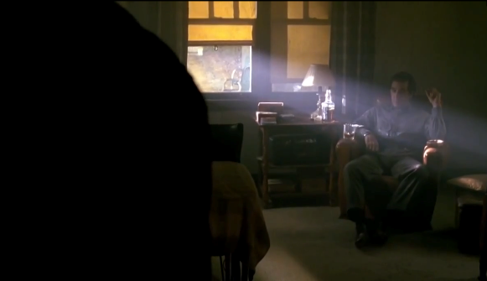
Shot type: Over the Shoulder shot
Movement: Still
Angle: Low
This scene occurs when Charlie and Frank first meet. The room is lighted with low key lighting and this has an depressing effect; carrying the features of the owner, Frank. The director chose an over the shoulder shot to show the dominance of Frank. Brest, wanted the audience to meet Frank as Charlie sees him. A low angle is used to make the audience the third person in the room, watching the events behind Charlie.

Slide 4
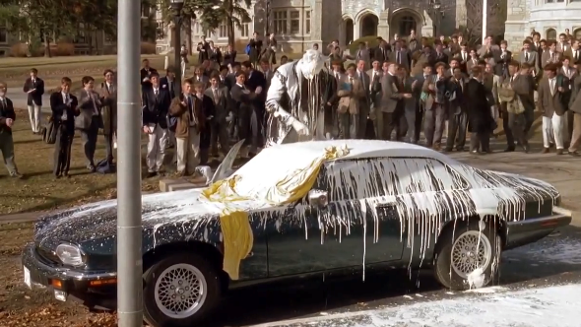
Shot type: Long Shot
Movement: Still
Angle: High
In this scene the principal of the school and his car get bombed by white paint. The director filmed this scene as a long shot to keep the viewers aware of the action, place and characters. Since the paint spills from above the car a high angle is used.

Slide 5
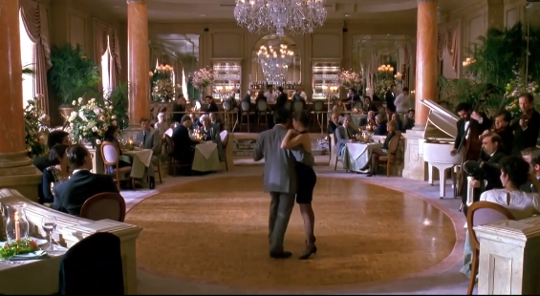
Shot type: Long shot
Movement: Tracking
Angle: High
This is probably the most important and effective dance scene in the cinema world. Frank who is blind teaches tango to a young woman he and Charlie met in the restaurant. The director chose a long shot and a high angle to include the setting; the people who stopped eating and started watching them and the orchestra. The camera is tracking because they are dancing and the director wanted the audience to feel like they are a part of the tango.

Slide 6
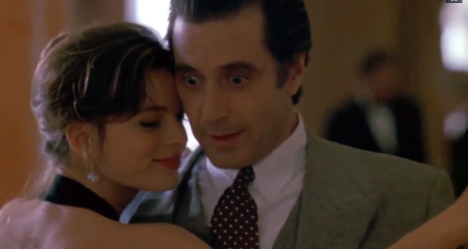
Shot type: Close-up
Movement: Tracking
Angle: Eye level
This close-up is again from the tango scene. The camera has been zoomed to show the emotions of the characters. Eye level is used to show us the joy in their faces and emphasize the blindness of Frank. Frank is both happy and surprised that he can dance with her only knowing the coordinates of the dance floor.

Slide 7
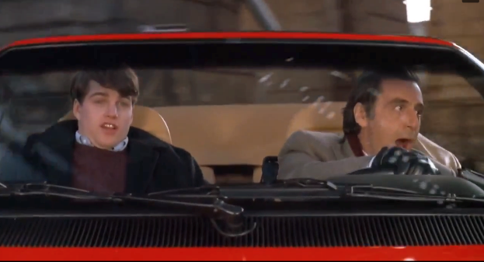
Shot types: Close-up
Movement: Still
Angle: Eye level
The director chose a close-up so the audience to understand the characters feelings. As Frank drives he is very excited and full of life however Charlie is scared to death. The blur of the camera indicates their speed.

Slide 8
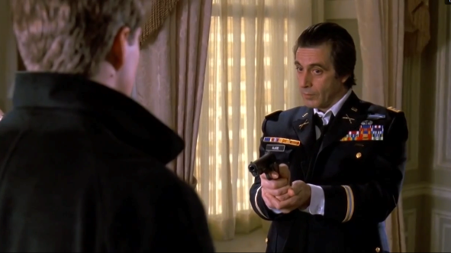
Shot type: Medium shot
Movement: Still
Angle: Low
The director chose a medium shot for the most intense scene in the film. Frank points a gun to Charlie when he tries to stop Frank‘s suicide. A low angle is used for both characters to have dominance in the frame. It is a still because the camera is focused on the gun action.

Slide 9
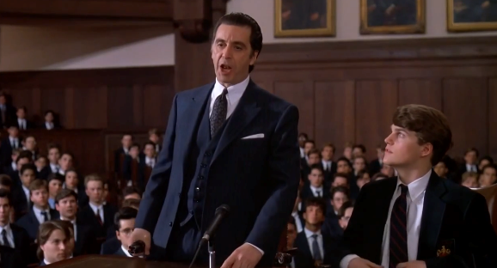
Shot type: Medium shot
Movement: Still
Angle: Low
The court in Charlie‘s school starts and Frank surprises him by showing up. He defends Charlie against the principal and jury. Part of the carefully listening audience is in the background and Charlie is shown alongside of Frank in the foreground. Charlie is happy because he is here with him but he is also worried about the things he will say since his talk is not very kind. The low angle helps Frank to dominate the screen with his intense talk and sudden movements.

Slide 10
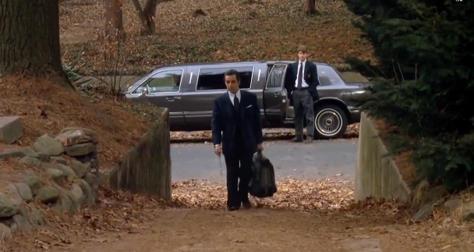
Shot type: Long shot
Movement: Still
Angle: Eye Level
In one of the last scenes of the film the end of Charlie and Frank‘s adventure is emphasized with a still shot. It is a touching scene when the whole film is evaluated. Frank took off before getting too sentimental. The director chose a long shot so we can see both characters clearly in the scene.

